Slide 1
PANIMALAR ENGINEERING COLLEGE DEPARTMENT OF CSE
SOCIALLY RELEVANT MINI PROJECT
RETROFIT
USER FRIENDLY FITNESS TRACKER
BY
LEO ASHWIN V (211422104249)
MOHAMED TARIQ ALI S(211422104278)
III CSE - G

Slide 2
INTRODUCTION
Overview:
The "User-Friendly Fitness Tracker" is designed to help users manage their health and fitness goals efficiently.
It offers personalized diet plans, exercise recommendations, and health monitoring tools using AI technology.
Importance of Fitness and Health Tracking:
Regular tracking of diet and exercise can lead to significant improvements in overall health and well-being.
Helps users stay motivated and on track with their fitness goals.
Provides insights into personal health trends and progress over time.

Slide 3
Features
1.Diet Plans
Weekly diet plans tailored for users
AI-based user-customized diet plans
2.Calorie Management
Track calories consumed and burned.
Exercise suggestions to burn specific calorie amounts
3.Self Checkup
Breathing exercises and self-checkup methods.
Nearby checkup center recommendations

Slide 4
HARDWARE REQUIREMENTS
Processor: Intel Core i5/i7
RAM: 8GB or more
Storage: SSD with at least 256GB
Graphics Card: Integrated graphics are sufficient, but a dedicated GPU (like NVIDIA GTX/RTX series) can be beneficial.
Monitor: Single monitor for efficient multitasking (1080p or higher resolution)
External Storage: For backups (e.g., an external SSD or HDD)
Network: Reliable internet connection (preferably wired for stability)
Keyboard and Mouse: Comfortable ergonomic setup

Slide 5
TOOLS USED
IDE: VS Code
Frontend:
HTML, CSS, JavaScript
JS Library: React
CSS Framework: Tailwind CSS
Fonts: Google Fonts
Icons: Iconify
Images: ImageKit
Database: FireBase
Git: Version control system.
GitHub CodeSpaces

Slide 6
EXISTING SYSTEM
Existing health apps often lack personalization, providing generic diet and exercise plans that do not cater to individual needs. Many calorie tracking apps are tedious and overlook the integration of exercise routines with dietary management. Fitness apps typically focus solely on workouts, neglecting dietary advice and personal safety features. Health monitoring apps offer fragmented solutions, requiring users to juggle multiple applications without real-time support.

Slide 7
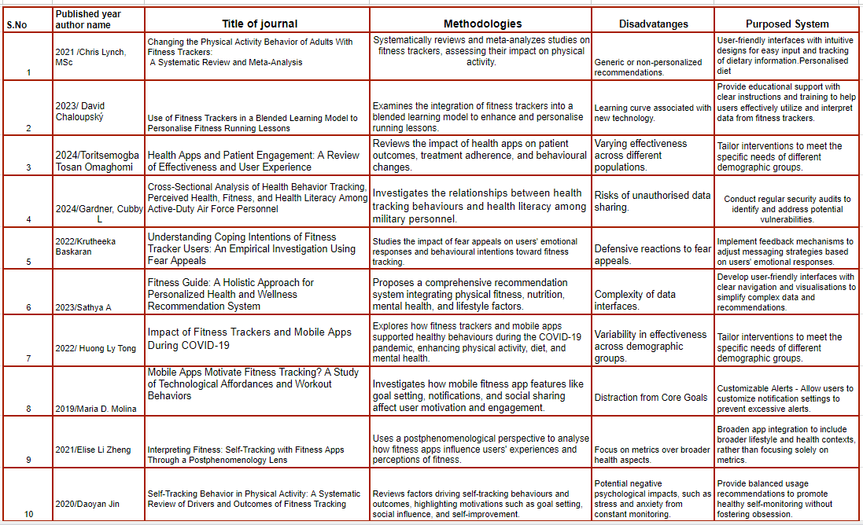

Slide 8
LITERATURE SURVEY
1. Changing the Physical Activity Behavior of Adults With Fitness Trackers: A Systematic Review and Meta-Analysis
Author: Chris Lynch, MSc
Date: December 20, 2021
Summary:Systematically reviews and meta-analysis studies on fitness trackers, assessing their impact on physical activity.
Problem: Generic or non-personalized recommendations.
Solution: User-friendly interfaces with intuitive designs for easy input and tracking of dietary information.
2. Use of Fitness Trackers in a Blended Learning Model to Personalise Fitness Running Lessons
Author: David Chaloupský
Date: June 2023
Summary: Examines the integration of fitness trackers into a blended learning model to enhance and personalise running lessons.
Problem: Learning curve associated with new technology.
Solution: Provide educational support with clear instructions and training to help users effectively utilize and interpret data from fitness trackers.

Slide 9
LITERATURE SURVEY
3. Health Apps and Patient Engagement: A Review of Effectiveness and User Experience
Author: Toritsemogba Tosan Omaghomi
Date: February 8, 2024
Summary: Reviews the impact of health apps on patient outcomes, treatment adherence, and behavioural changes.
Problem: Varying effectiveness across different populations.
Solution: Regular updates to address technical issues, enhance functionality, and improve overall performance.
4. Cross-Sectional Analysis of Health Behavior Tracking, Perceived Health, Fitness, and Health Literacy Among Active-Duty Air Force Personnel
Author: Gardner, Cubby L
Date: March 2024
Summary: Investigates the relationships between health tracking behaviours, perceived health status, fitness levels, and health literacy among military personnel.
Problem: Risks of unauthorised data sharing.
Solution: Conduct regular security audits to identify and address potential vulnerabilities.

Slide 10
LITERATURE SURVEY
5. Understanding Coping Intentions of Fitness Tracker Users: An Empirical Investigation Using Fear Appeals
Author: Krutheeka Baskaran
Date: September 2022
Summary: Studies the impact of fear appeals on users' emotional responses and behavioural intentions toward fitness tracking.
Problem: Defensive reactions to fear appeals.
Solution: Implement feedback mechanisms to adjust messaging strategies based on users' emotional responses.
6. Fitness Guide: A Holistic Approach for Personalized Health and Wellness Recommendation System
Author: Sathya A
Date: September 2023
Summary: Proposes a comprehensive recommendation system integrating physical fitness, nutrition, mental health, and lifestyle factors.
Problem: Complexity of data interfaces.
Solution: Develop user-friendly interfaces with clear navigation and visualisations to simplify complex data and recommendations.

Slide 11
LITERATURE SURVEY
7. Interpreting Fitness: Self-Tracking with Fitness Apps Through a Postphenomenology Lens
Author: Elise Li Zheng
Date: February 7, 2021
Summary: Uses a postphenomenological perspective to analyse how fitness apps influence users' experiences and perceptions of fitness.
Problem: Focus on metrics over broader health aspects.
Solution: Broaden app integration to include broader lifestyle and health contexts, rather than focusing solely on metrics.
8. Impact of Fitness Trackers and Mobile Apps During COVID-19
Author: Huong Ly Tong
Date: August 18, 2022
Summary: Explores how fitness trackers and mobile apps supported healthy behaviours during the COVID-19 pandemic, enhancing physical activity, diet, and mental health.
Problem: Variability in effectiveness across demographic groups.
Solution: Tailor interventions to meet the specific needs of different demographic groups.

Slide 12
LITERATURE SURVEY
9. Mobile Apps Motivate Fitness Tracking? A Study of Technological Affordances and Workout Behaviors
Author: Maria D. Molina Date: 13 September 2019 Summary: Investigates how mobile fitness app features like goal setting, notifications, and social sharing affect user motivation and engagement. Problem: Distraction from Core Goals Solution: Customizable Alerts - Allow users to customize notification settings to prevent excessive alerts.
10. Self-Tracking Behavior in Physical Activity: A Systematic Review of Drivers and Outcomes of Fitness Tracking
Author: Daoyan Jin
Date: August 5, 2020
Summary: Reviews factors driving self-tracking behaviours and outcomes, highlighting motivations such as goal setting, social influence, and self-improvement.
Problem: Potential negative psychological impacts, such as stress and anxiety from constant monitoring.
Solution: Provide balanced usage recommendations to promote healthy self-monitoring without fostering obsession.

Slide 13
PROPOSED SYSTEM
Personalized Diet Plans: The app uses AI to generate customized weekly meal plans based on individual preferences, dietary restrictions, and health goals, promoting balanced nutrition.
User-Friendly Interface: Designed for simplicity, the app ensures that all features are easily accessible, making it straightforward for users to manage their health effectively.
Easy navigation throughout the app
Gather user feedback for continuous improvement

Slide 14

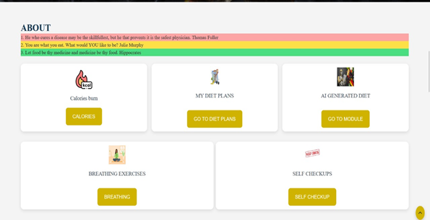
HOW IT WORKS

Slide 15
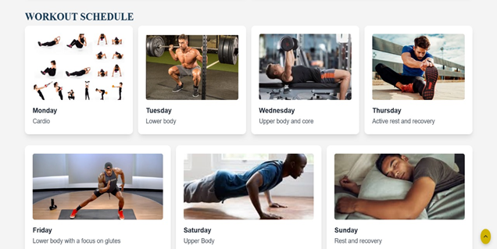
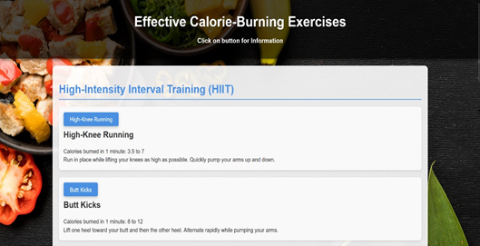

Slide 16


Slide 17
CONCLUSION
Availability of health management applications which relates to personalised diet and exercising plans has been proved effective in improving health in urban dwellers. As highlighted by the results of this present systematic review, the use of such technology applications help in the prevention of unhealthy behaviours. With future development of various kinds of technology in the use of health applications, incorporating new features like personalised nutrition tracking, exercise reminders, and health-tracking functions can help individuals to own their individual health transformations.

Slide 18

THANK YOU
BY :

